Slide 1
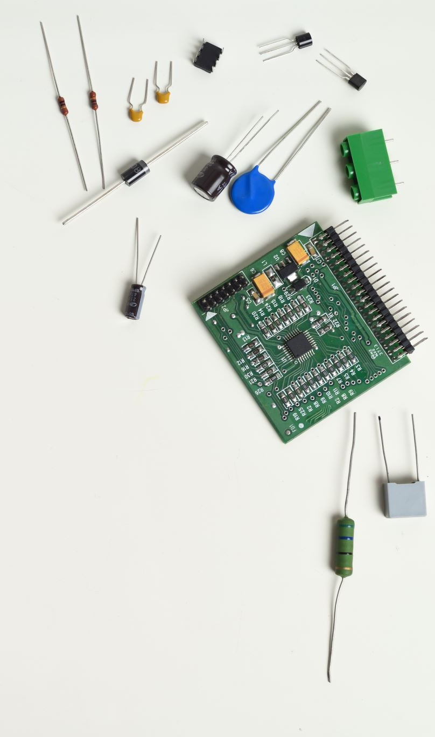
8086 Microprocessor
Program controlled semiconductor device (IC) which fetches (from memory), decodes and executes instructions.
It is used as CPU (Central Processing Unit) in computers.

Slide 2
Features of 8086 Microprocessor
The 8086 is a 16-bit microprocessor.
The 8086 has a 16-bit data bus, so it can read data from or write data to memory and ports either 16 bits or 8 bits at a time.
The 8086 has a 20-bit address bus, so it can directly access 2²⁰ or 10,48,576 (1Mb) memory locations.
The 8086 provides fourteen 16-bit registers.
The Intel 8086 is designed to operate in two modes, namely the minimum mode and the maximum mode.
It performs the arithmetic and logical operations on bit, byte, word and decimal numbers including multiply and divide.

Slide 3
Fifth Generation Pentium
Fourth Generation
During 1980s
Low power version of HMOS technology (HCMOS)
32 bit processors
Physical memory space 2²⁴ bytes = 16 Mb
Virtual memory space 2⁴⁰ bytes = 1 Tb
Floating point hardware
Supports increased number of addressing modes
Intel 80386
Third Generation
During 1978
HMOS technology ⇒ Faster speed, Higher packing density
16 bit processors ⇒ 40/ 48/ 64 pins
Easier to program
Dynamically relatable programs
Processor has multiply/ divide arithmetic hardware
More powerful interrupt handling capabilities
Flexible I/O port addressing
Intel 8086 (16 bit processor)
Second Generation
During 1973
NMOS technology ⇒ Faster speed, Higher density, Compatible with TTL
4 / 8/ 16 bit processors ⇒ 40 pins
Ability to address large memory spaces and I/O ports
Greater number of levels of subroutine nesting
Better interrupt handling capabilities
Intel 8085 (8 bit processor)
First Generation
Between 1971 – 1973
PMOS technology, non compatible with TTL
4 bit processors ⇒ 16 pins
8 and 16 bit processors ⇒ 40 pins
Due to limitations of pins, signals are multiplexed

Slide 4
Functional blocks
Various conditions of the results are stored as status bits called flags in flag register
Computational Unit; performs arithmetic and logic operations
Internal storage of data
Register array or internal memory
Data Bus
ALU
Generates the address of the instructions to be fetched from the memory and send through address bus to the memory
Flag Register
Instruction decoding unit
Timing and control unit
PC/ IP
Control Bus
Address Bus
Generates control signals for internal and external operations of the microprocessor
Decodes instructions; sends information to the timing and control unit

Slide 5

Overview of 8086
First 16- bit processor released by INTEL in the year 1978
Originally HMOS, now manufactured using HMOS III technique
Approximately 29, 000 transistors, 40 pin DIP, 5V supply
20-bit address to access memory ⇒ can address up to 2²⁰ = 1 megabytes of memory space.
Addressable memory space is organized in to two banks of 512 kb each; Even (or lower) bank and Odd (or higher) bank. Address line A₀ is used to select even bank and control signal $\overline{BHE}$
is used to access odd bank
Uses a separate 16 bit address for I/O mapped devices ⇒ can generate 2¹⁶ = 64 k addresses.
Operates in two modes: minimum mode and maximum mode, decided by the signal at MN and $\overline{MX}$ pins.
Notes:
DIP- Dual Inline Package

